Slide 1


Agenda#14
5/18/2026
May 2026
Board Meeting
Save the Date!
2026 Annual Luncheon
Friday August 21, 2026
The Rusty Pelican
11:30-1:00pm

Slide 2
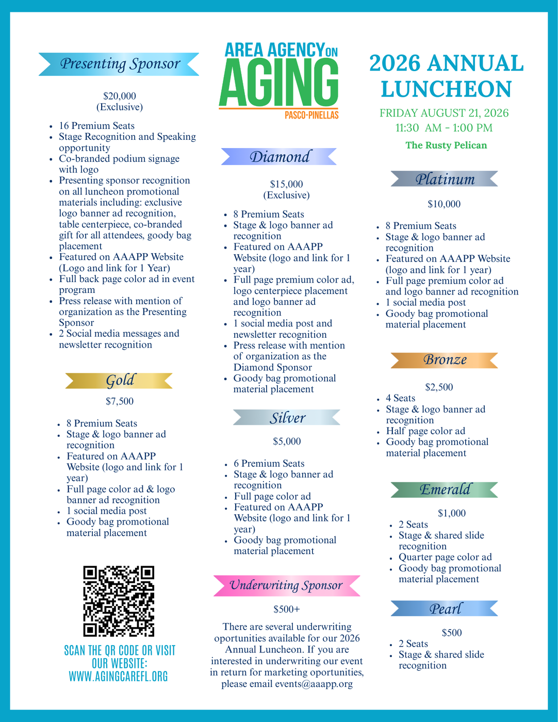
May 2026
Board Meeting
Benefit for 2026 Annual Luncheon
  Funds raised for the 2026 Annual Luncheon are to be unrestricted, in order to promote and support AAAPP and its mission to provide Wrap around care and services to seniors in Pasco and Pinellas Counties.
Sponsorship Packet
Website - Bloomerang Link
Emcee - Courtney Robinson, Anchor 10 Tampa Bay

Slide 3
May 2026
Board Meeting
Current Committed and or Pledged Sponsors: $48,400
Gold:
  ArchWell Health
Silver:
  BayCare Health Sysetm, Inc.
  David Alvarez/Carr, Riggs and Ingram
  Dominium
  Pinellas County Housing Authority
Bronze:
  Seacoast Bank
  UBS/Matt Gordon
Emerald:
  Ann Marie Winter
  Barbara Epstein
  Brown & Brown
  Cavanaugh & Co.
  Dedicated Senior Medical Care
  Florida Representative Linda Chaney
  Guardian Angel Homecare Services
  Health Aid Company
  Infotect Design Solutions
  Norm Bungard
  SeaBreeze Adult Day Center
  Theresa Ziegler/Ruth’s Promise Adult Day Program
Pearl:
  Bay Area Legal Services
  Daycations Adult Daycare
  EXIT Suncoast Realty
  Gulf Coast JFCS
  Menorah Life
  Mutual of America
  Pinellas County Commissioner Dr. Rene Flowers

Slide 4
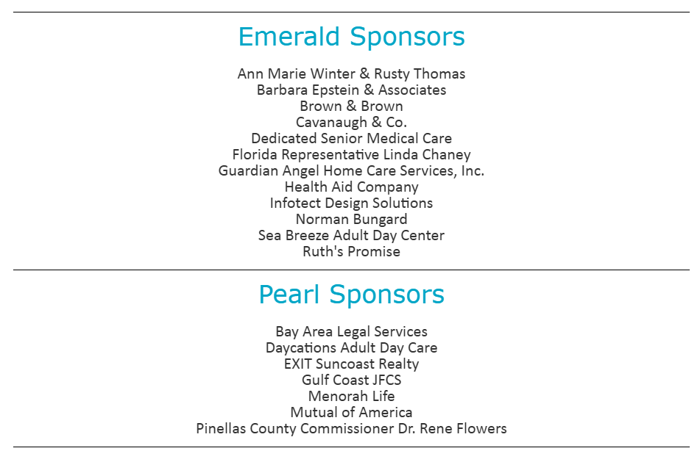




May 2026
Board Meeting
2026 Annual Luncheon website updates

Slide 5

May 2026
Board Meeting
Promotional video!

Slide 6
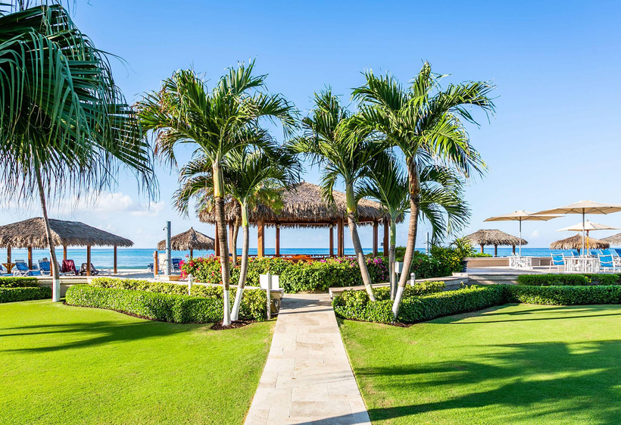
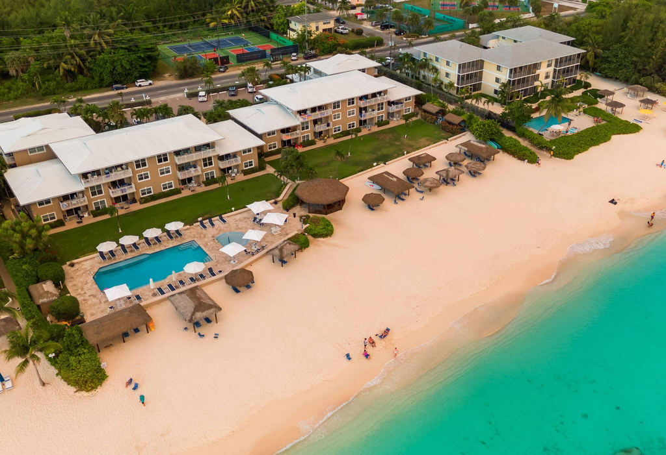
May 2026
Board Meeting
Featured In-Kind donation
Grand Cayman Getaway
Thanks to Judge Jirotka, we are honored to announce that he has graciously donated a week long stay in a garden-view condo that sleeps 4. This will be included in our day of fundraising efforts via auction.
We are looking to make this an incredible package offering for our attendees to include gift cards for airfare or a dining certificate from a local restaurant close to the condo location.
Additional in-kind support is needed and greatly appreciated!
Deadline to receive print recognition in 2026 Luncheon Program will be July 27,2026

